Slide 1
Internet business concepts Week #1: the history of the modern internet
March 2018 v1.3

Slide 2
How did we get to today’s internet?
You’re enrolled in a course that will teach you the latest web development technology including:
How to design the best visual elements of a website
How to create a great user experience
How to code a website
An understanding of SEO & different ways to use internet marketing
But let’s take a moment to understand how we got to today’s modern web practices

Slide 3
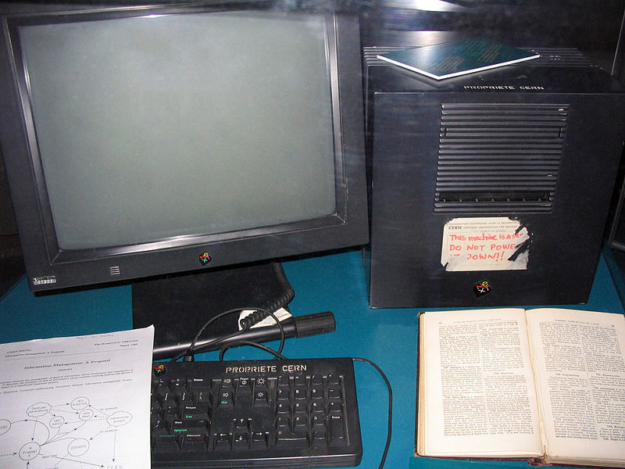
Internet history: 1960-1989
1960s: The US military begins awarding contracts to computer manufactures for “packet system networks”, to enable military installations & laboratories to remain connected in peace & wartime situations
1982-1986: Standard internet communication protocol practices begin to be implemented. More interconnectivity between hubs.
1989: Tim Berners-Lee introduces the concept of Hypertext Protocol Transfer (HTTP) – the birth of a webpage.
1990: First web server launched in CERN.

Slide 4
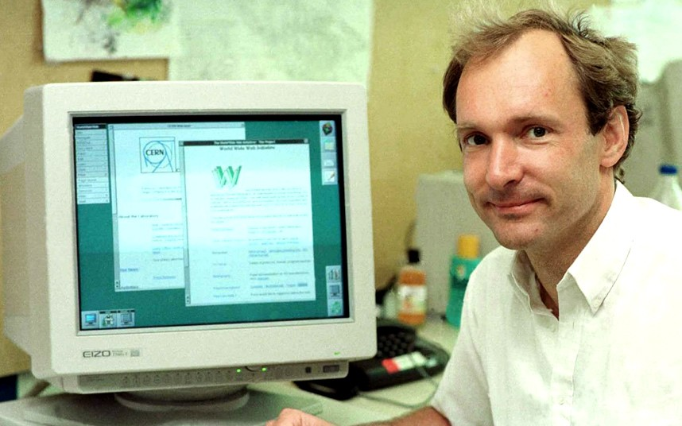
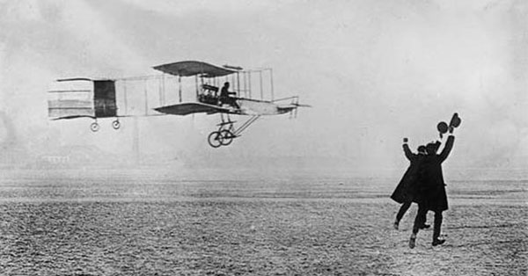
1990 is important like 1903 is important

Slide 5


1993: Mozilla arrives
In 1993 Marc Andreessen creates & releases Mozilla, which redefines the
Web browsing experience.
1993-1995: The World Wide Web rapidly enters the mainstream, with new terminology entering pop culture: website, browsers, surfing the web.
Would
later
become

Slide 6
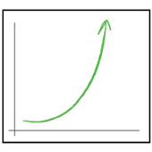
Internet user growth over last 20 years
1993: 14 million
1995: 44 million
1998: 188 million
2000: 414 million
2001: 502 million
2003: 781 million
2005: 1.03 billion
2008: 1.5 billion
2011: 2 billion
2013: 2.7 billion
2015: 3.18 billion
2016: 3.42 billion

Slide 7
The birth of google
March 1996: The first Google web crawler program appears. It begins to index webpages on the Internet as a research attempt by 2 university students. The program assigns a value to a page by its “importance” – links to it, server accessibility, how many times a search term appeared on the page.
While other “link directories” exist at the time, Google changed the game with its approach, grading of webpages and simplicity.

Slide 8
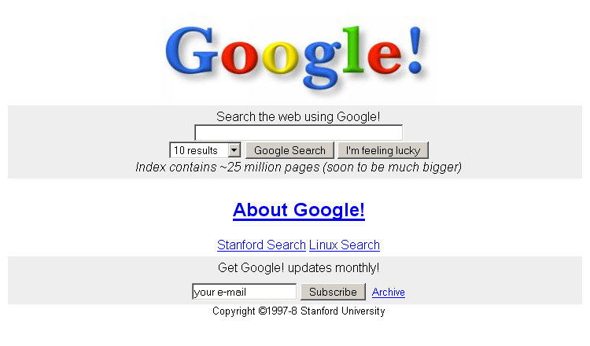
Google homepage screenshot from 1997

Slide 9
The importance of google’s introduction
Instead of having to manually submit your website to a link directory (Yahoo, Ask Jeeves, DMOZ), Google went out and looked for links on websites it already knew about – and then followed those links & added those websites to its directory
This was the first concept of a search engine
Online ads were in their infancy, and Google wasn’t in the ad game at this stage of their business
Other competitors were building gated communities (AOL), link directories, or independent website portals

Slide 10
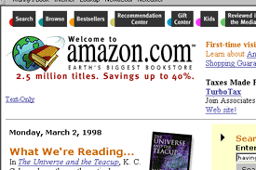
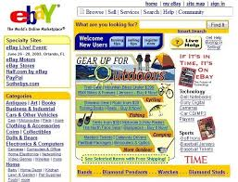
Other early players that became leaders in their internet domains

Slide 11
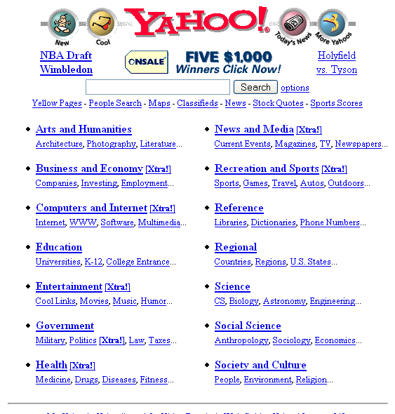
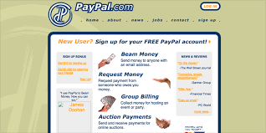
Other early players that became leaders in their internet domains

Slide 12
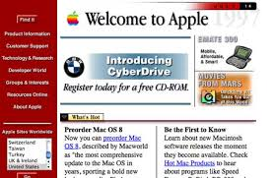
But there were mistakes made in web 1.0
No consistency between different websites (e.g. navigation bars)
No knowledge of preferred user behavior
Analytics were basic & didn’t cover user functionality

Slide 13
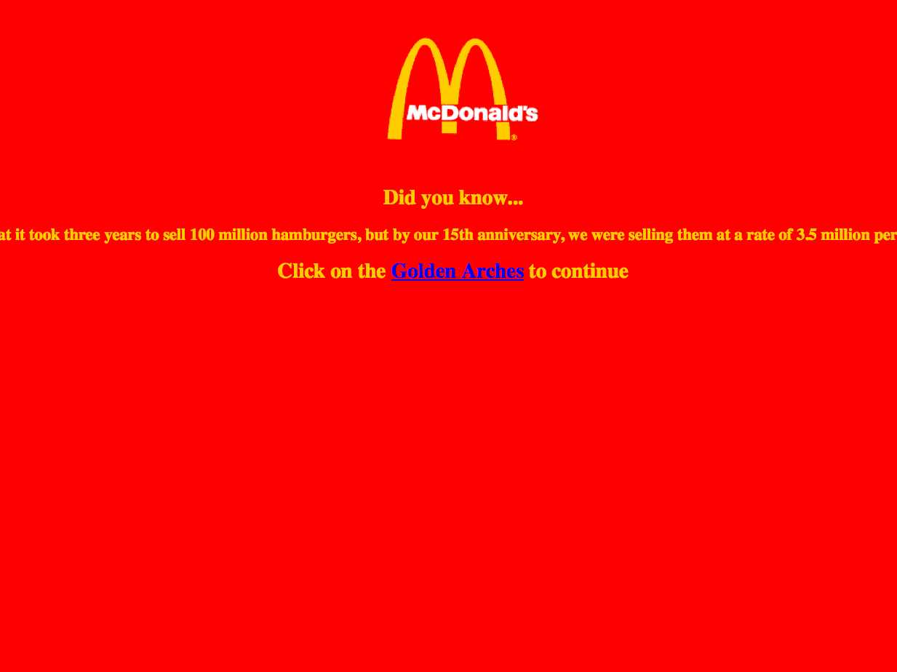
But there were mistakes made in web 1.0
Static HTML = basic, takes minutes to load homepage
Internet attention spans – how long were they & why?
Image optimization? What’s that?

Slide 14
Early 200s: web 2.0 arises
Richer user experiences, focus on appeasing user’s intent
Deeper analytics uncovered user behavior patterns
Increased functionality
No more frames, better HTML, dynamic websites
Flash allows for more interactivity, but Apple doesn’t adopt it
Move towards using “negative space” in design
Introduction of “call to action” grid or button

Slide 15
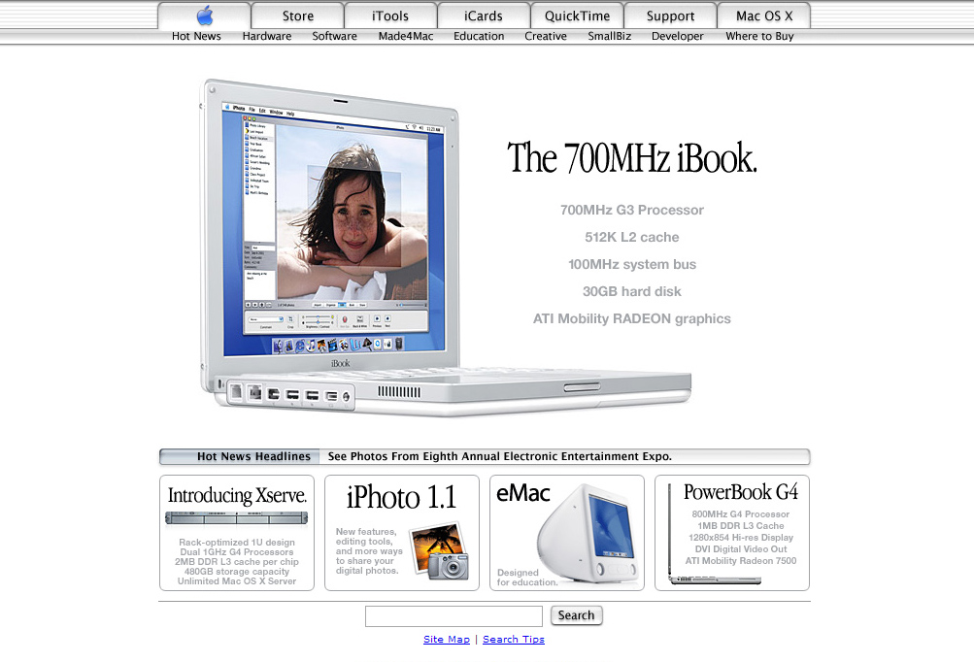
Apple’s website circa 2002

Slide 16
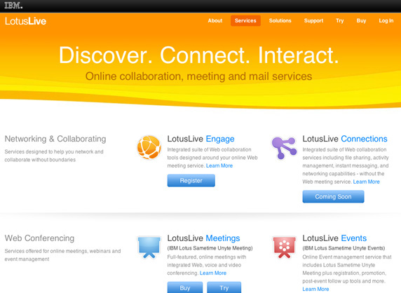
IBM’s Homepage circa 2004.
Headline is simple (3 words)
4 call-to-action buttons (twice to many by today’s standards)
Text isn’t overwhelming to reader
Clean navigation bar

Slide 17

Real Estate homepage circa 2005
Nothing fancy, easy to understand page layout.
More text than the IBM homepage example, but that’s OK for search engines.
Navigation bar in top strip
Graphics that easily visually identify what kind of site it is – house graphics!

Slide 18
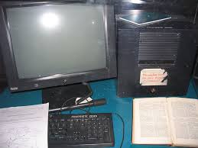

1990: 1st website & browser
1993: Mosaic launches
1994: Yahoo!, Amazon launches
1997: Google launches
2001: Dotcom bubble bursts
2002: Web 2.0
2005: YouTube launches
2006: Twitter launches
2010: Instagram launches
2012: Facebook 1B users
2014: Alibaba: $9.3B in 1 day
2016: Alibaba: $17.7B in 1 day
1903: 1st powered flight
1906: France & Brazil fly
1910: 1st seaplane (then called flying boat)
1911: 1st military aircraft (scouting)
1913: 1st commercial passenger flight
1914: 1st gun mounted aircraft
1918: Airmail launched
1919: 1st parachute jump
1924: 1st round-the-world flight
1926: 1st polar flight
1927: Solo flight across the Atlantic Ocean
1929: 1st around the world flight

Slide 19

What users want from websites today
Simplicity: ease of design, navigation, functionality, one-click away answers
Mobile: Increasing use of mobile devices mean all websites need to be functional for different user experiences (desktop, tablet, phone)
Clarity / Understanding of audience: If a website is a resource (like Wikipedia or a university), loads of content. eCommerce? Clean images, strong call to action. Your website doesn’t need to be “shiny” if your audience doesn’t expect it.

Slide 20

What users want from websites today
Split-second decision making:
Internet users want to know they’re on the right kind of website to solve their present problem.
Does your headline communicate that?
Do your images? Does your call to action make them want to take action?

Slide 21

What users want from websites today
Fast-loading time: Not only does this help keep users on the website, it also now factors into search engine results.
Slower loading sites = on 2nd, 3rd pages of search engine results.
Guidance: Users want to be told by the site what to do – but to not be told overtly or forcefully. Let them take the action naturally.

